Slide 2
The Design Procedure
Part 2
Specification
Formulation - Obtain a state diagram or state table
State Assignment - Assign binary codes to the states
Part 3
Flip-Flop Input Equation Determination - Select flip-flop types and derive flip-flop equations from next state entries in the table
Output Equation Determination - Derive output equations from output entries in the table
Technology Mapping - Find circuit from equations and map to flip-flops and gate technology

Slide 3
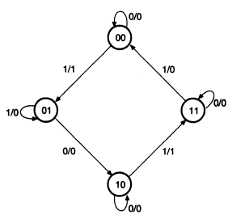
Example State Diagram

Slide 4
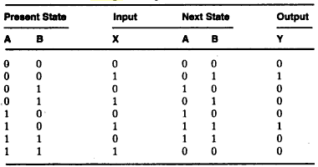

State Assignment

Slide 5
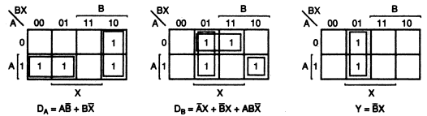

Input Equation: K-Map or Directly

Slide 6
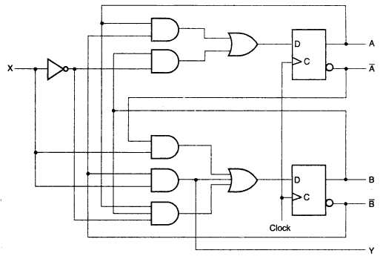
Logic Diagram Using D Flip-flops

Slide 7
Another Example: State Assignment
Present
Next State
Output
State
x=0 x=1
x=0 x=1
A
A B
0 0
B
A C
0 0
C
D C
0 0
D
A B
0 1

Slide 8
State Assignment : Assignment 1
Assignment 1: A = 0 0, B = 0 1, C = 1 0, D = 1 1
The resulting coded state table:
Present State | Next State x = 0 x = 1 |  | Output x = 0 x = 1
0 0 | 0 0 | 0 1 | 0 | 0
0 1 | 0 0 | 1 0 | 0 | 0
1 0 | 1 1 | 1 0 | 0 | 0
1 1 | 0 0 | 0 1 | 0 | 1

Slide 9
Find Flip-Flop Input and Output Equations: Assignment 1
Present State | Next State x=0 x=1 |  | Output x=0 x=1
0 0 | 0 0 | 0 1 | 0 | 0
0 1 | 0 0 | 1 0 | 0 | 0
1 0 | 1 1 | 1 0 | 0 | 0
1 1 | 0 0 | 0 1 | 0 | 1
Y1 Y2 X | Next State D1 D2 | Output Z
0 0 0 | 0 0 | 0
0 0 1 | 0 1 | 0
0 1 0 | 0 0 | 0
0 1 1 | 1 0 | 0
1 0 0 | 1 1 | 0
1 0 1 | 1 0 | 0
1 1 0 | 0 0 | 0
1 1 1 | 0 1 | 1

Slide 10
Find Flip-Flop Input and Output Equations: Assignment 1
Assume D flip-flops
You can draw K-maps or get the relations directly from the minterms
D₁ = Y₁Y₂ + Y₁Y₂X D₂ = Y₁Y₂ X + Y₁Y₂ X+ Y₁Y₂X Z = Y₁Y₂X

Slide 11
State Assignment: Assignment 2
Assignment 2: A = 0 0, B = 0 1, C = 1 1, D = 1 0
The resulting coded state table:
Present State | Next State x = 0 x = 1 |  | Output x = 0 x = 1
0 0 | 0 0 | 0 1 | 0 | 0
0 1 | 0 0 | 1 1 | 0 | 0
1 1 | 1 0 | 1 1 | 0 | 0
1 0 | 0 0 | 0 1 | 0 | 1

Slide 12
Optimization: Example 2: Assignment 2
D₁ = Y₁Y₂ + XY₂
D₂ = X Z = XY₁Y₂
Y1
D
C
R
Z
Y2
X
D
Clock
C
R
Reset

Slide 13
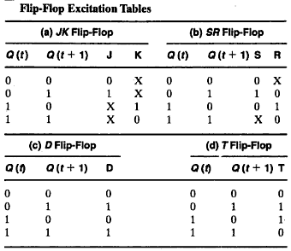
Flip-flop Exciting Tables

Slide 14
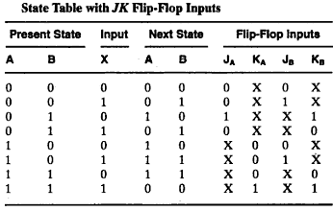
Design With JK Flip-flops

Slide 15
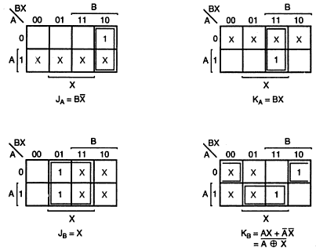
Design With JK Flip-flops

Slide 16
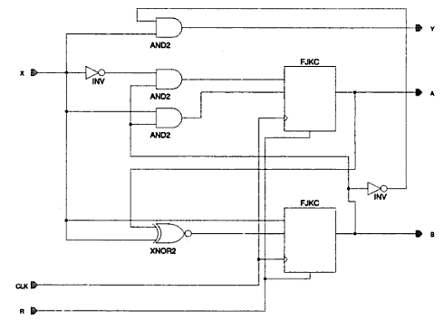
Design With JK Flip-flops

